Slide 1
I400 – Application Development in Java
Lecture 9

Slide 2
Today
CH 12 – Exception Handling
Dates (Actually CH 9)
ArrayLists & ArrayList methods (Actually CH 11)
Exceptions
try / catch / finally
throw / throws

Slide 3
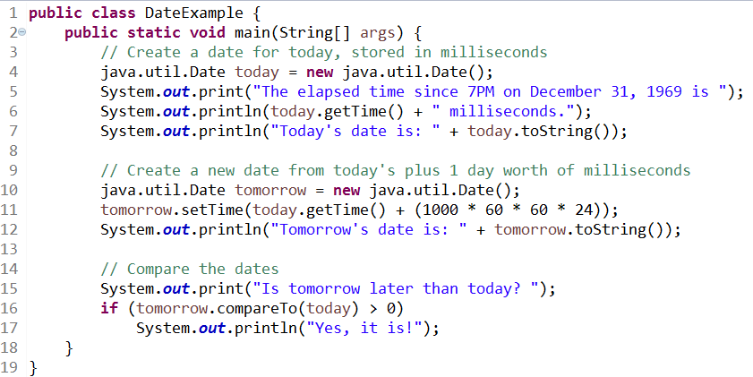

Brief Aside - Dates
Java has a useful built-in class for dates.

Slide 4
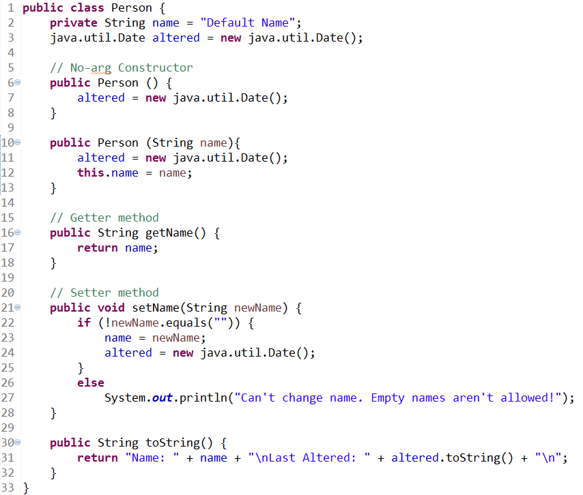
Overriding
We could use this to timestamp our instances:

Slide 5
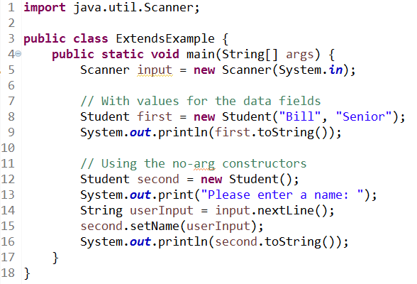
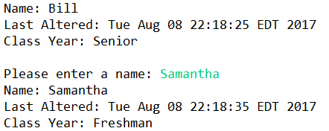
Overriding

Slide 6
ArrayList
Arrays in Java are like tuples in Python – limited in certain ways.
However, there is a class we can bring in that behaves more like a list from Python – the ArrayList class!
We have to import it at the top of the file:
import java.util.ArrayList;

Slide 7
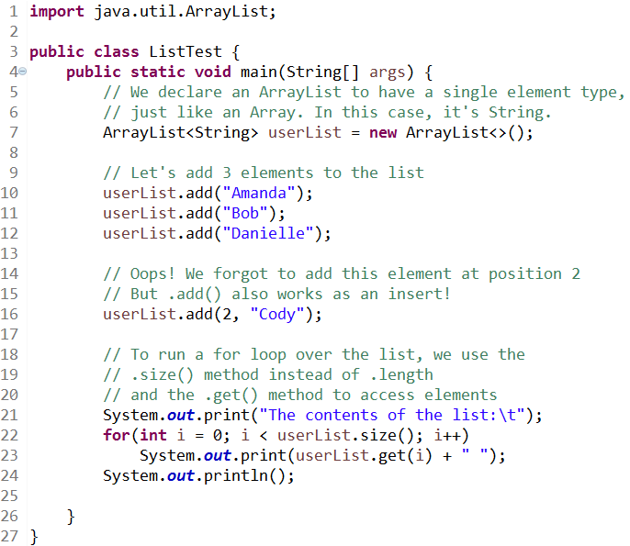
ArrayList: .add(), .size(), .get()

Slide 8
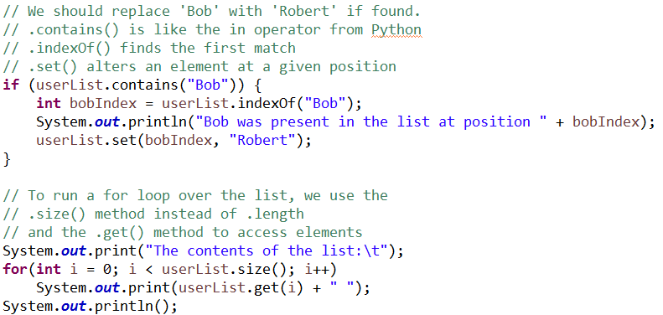
ArrayList: .contains(), .indexOf(), .set()

Slide 9
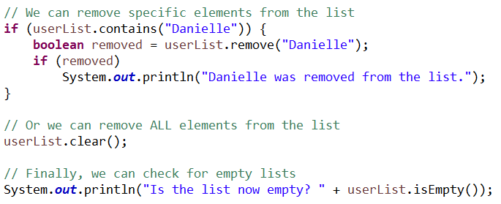

ArrayList: .remove(), .clear(), .isEmpty()

Slide 10
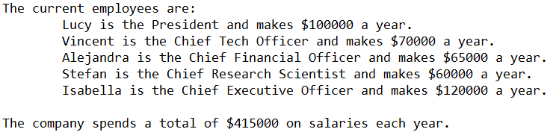
Employee List (Group Work)
Create an ArrayList to store Employees, and:
Add at least 5 Employees to your list.
Output the contents of the list in detail.
Compute the total of all salaries. (You’ll need to add a new access method for salary to Employee)
Lost your Employee code? Get EmployeeList.java from Canvas.

Slide 11
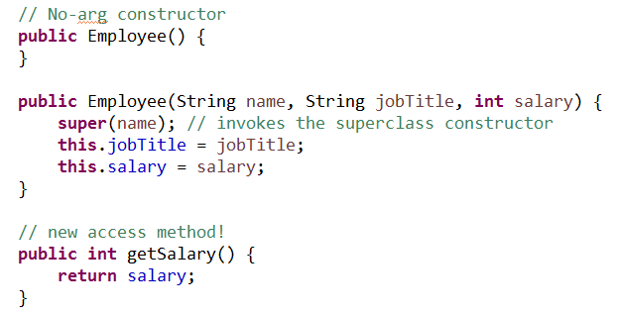
Employee List (Solution pt 1)

Slide 12
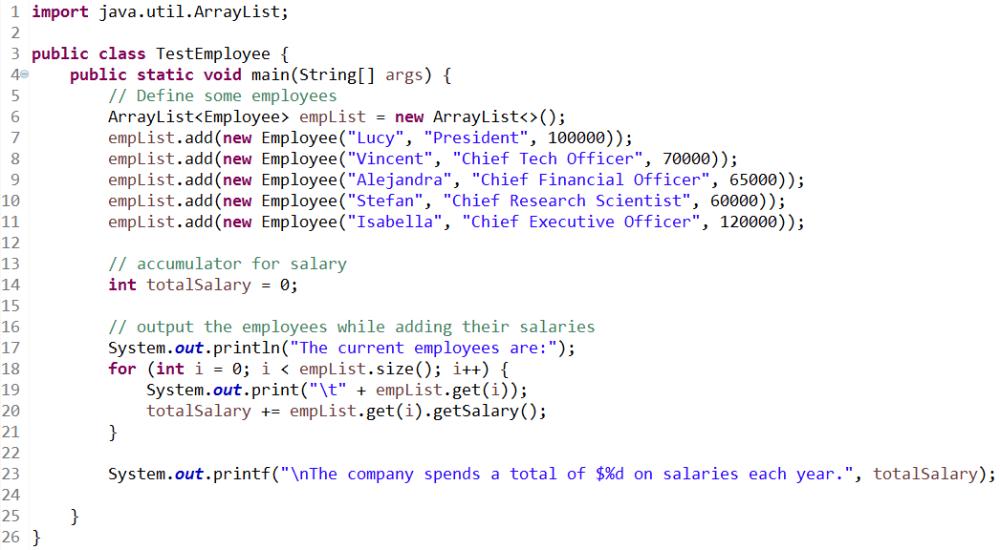
Employee List (Solution pt 2)

Slide 13
Exception Handling
There are many things we can do in Java to cause our programs to crash.
We could:
try to access a part of an array that doesn’t exist
reference an object that has no value
divide by zero
try to write to a non-existent file
Just like Python, Java provides robust exception handling.

Slide 14
Exception Handling
Exception handling allows us to create structures where our programs delegate responsibility for or centralize the handling of errors that occur at run-time.
Exception handling does NOT replace simple logic tests for values outside of allowable ranges.

Slide 15
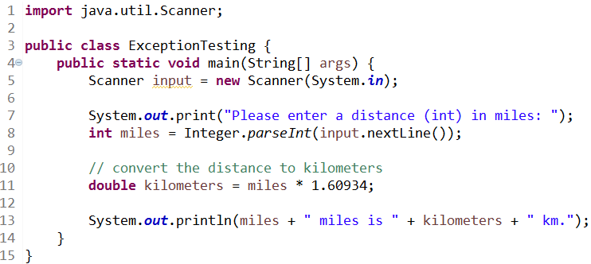
Exception Handling
Let’s take a look at a situation where a runtime error might occur:
What happens if the input isn’t an integer?

Slide 16
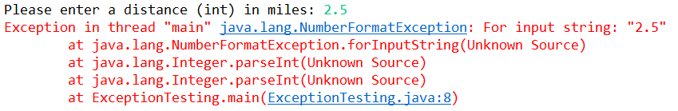
Exception Handling
What happens if the input isn’t an integer?

Slide 17
try / catch
We use the keyword try to surround a block of code that might cause an exception.
We use the keyword catch to designate code to run if a particular exception occurs. This is like the except keyword in Python.
We can also use a System.exit(1) call to immediately end the program.

Slide 18
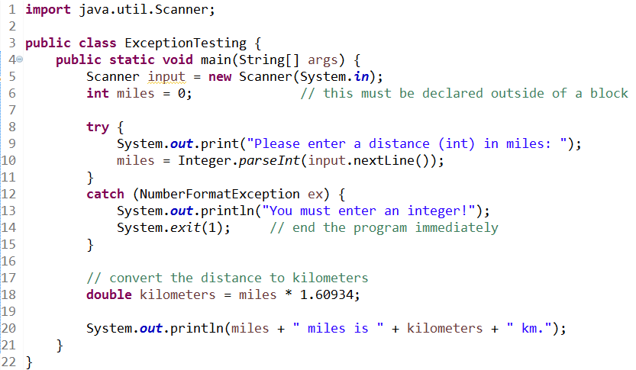


try / catch

Slide 19
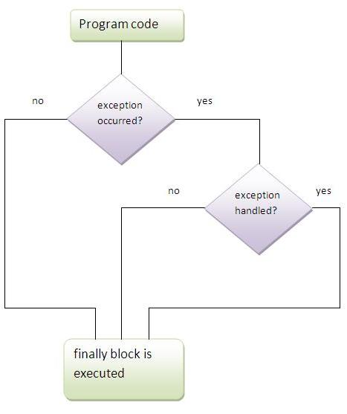
finally
In addition to a try block and a catch block, you can add a finally block that will run in almost any case.
If the catch block exits the program with a System.exit() call, the finally block isn’t executed.

Slide 20
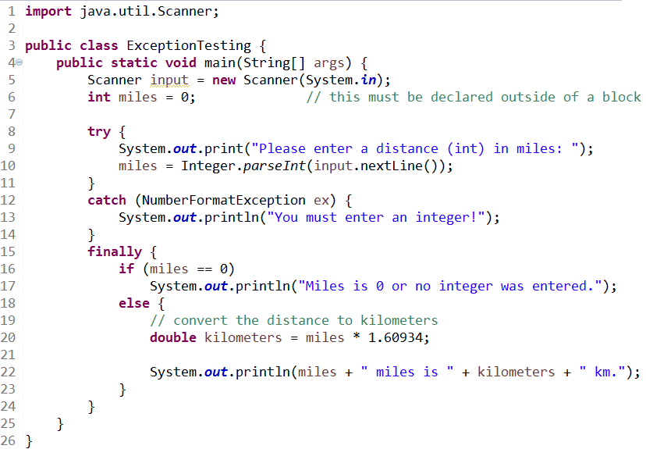
try / catch / finally

Slide 21
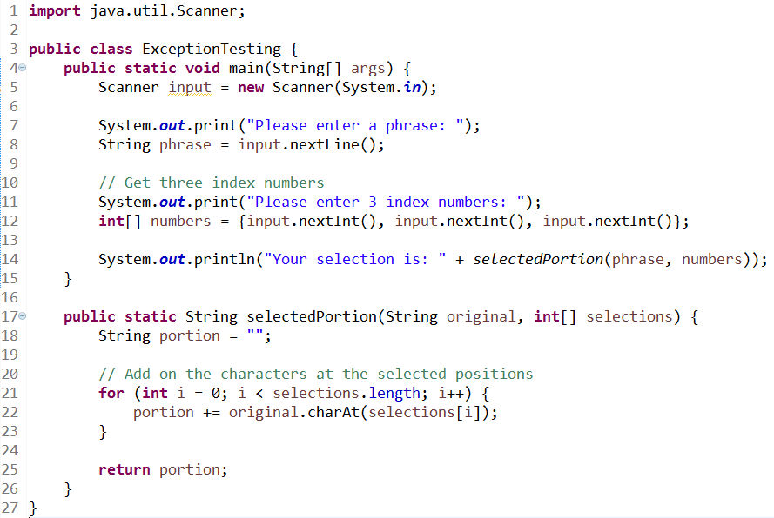
Exception Handling
Sometimes, exceptions arise in our methods, and we might want to handle them elsewhere:

Slide 22

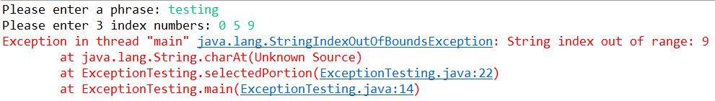
Exception Handling
Sometimes, exceptions arise in our methods, and we might want to handle them elsewhere:

Slide 23
throw / throws
If we want our method to pass control of the situation back to where it was called, we can have it throw an exception. This usually involves creating a new Exception object.
Exception is the superclass to all other types of exception, so we can (and often should) throw a more specific exception, like ArithmeticException or NullPointerException.

Slide 24
throw / throws
When a method is capable of producing an exception that it won’t be handling, we need to add a modifier to the method’s signature (first line).
We use the throws keyword to indicate that this method might produce this exception. Java will require the calling location to handle the exception in a try/catch block.

Slide 25
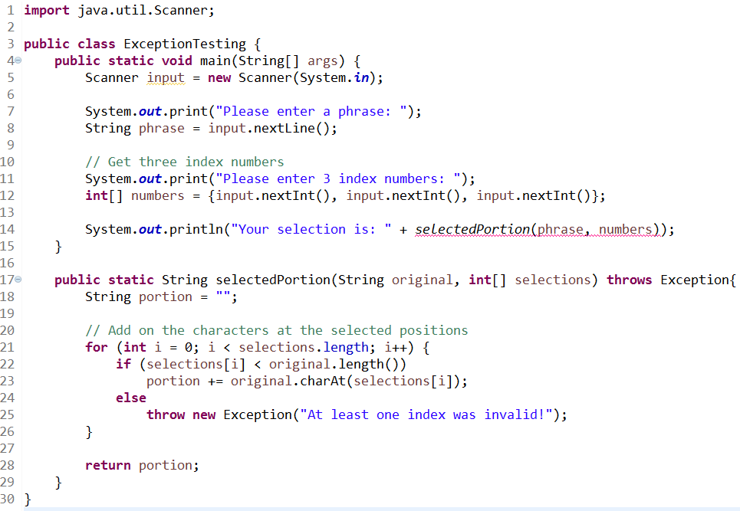

throw / throws

Slide 26
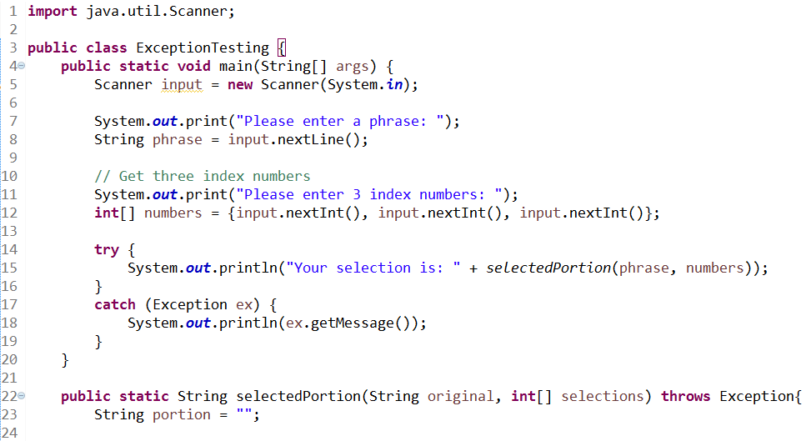

throw / throws

Slide 27
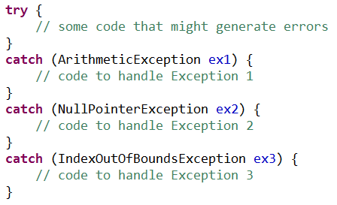
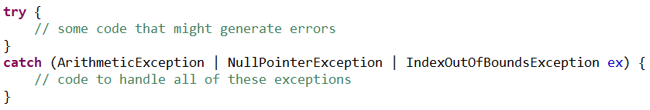
Handling Multiple Exceptions
If our code could throw many different types of Exceptions, we have two options:

Slide 28
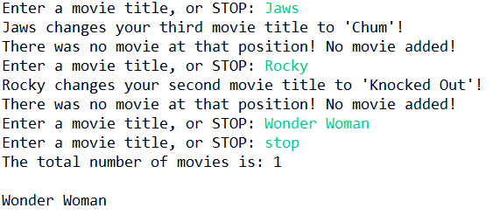
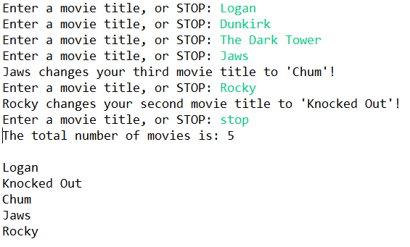
Exceptional Movies (Group Work)
Download AddExceptions.java from Canvas. The code in this file throws exceptions under certain circumstances, but they aren’t being handled. Fix that by handling the SPECIFIC exception. Try entering “Jaws” as your first movie to generate the error.
Two runs are shown here, using the corrected code:

Slide 29
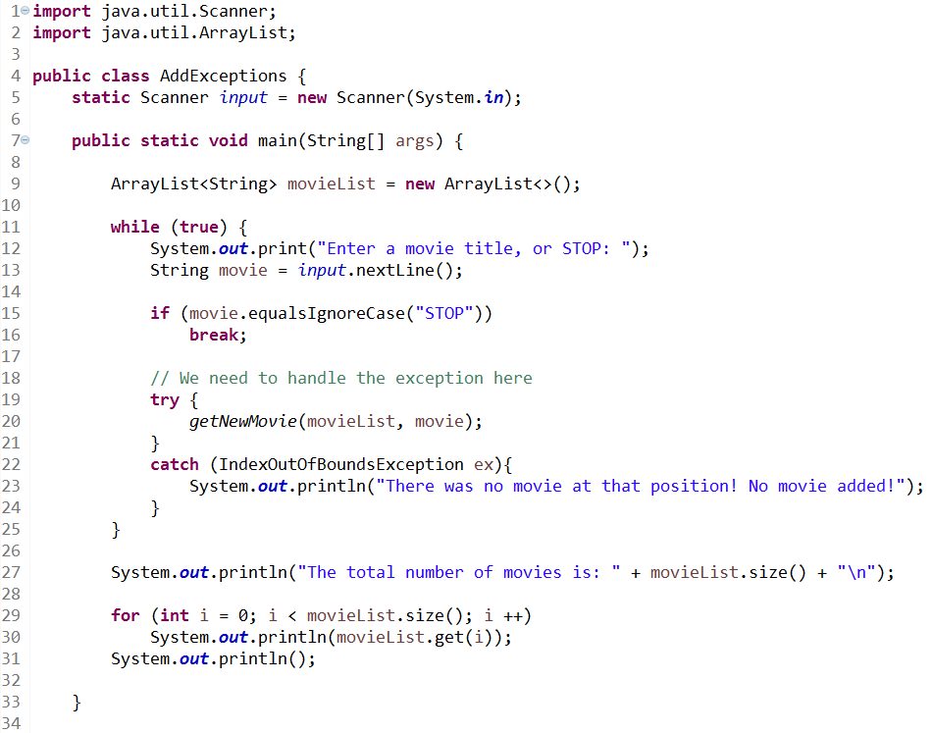
Exceptional Movies (Solution pt 1)

Slide 30
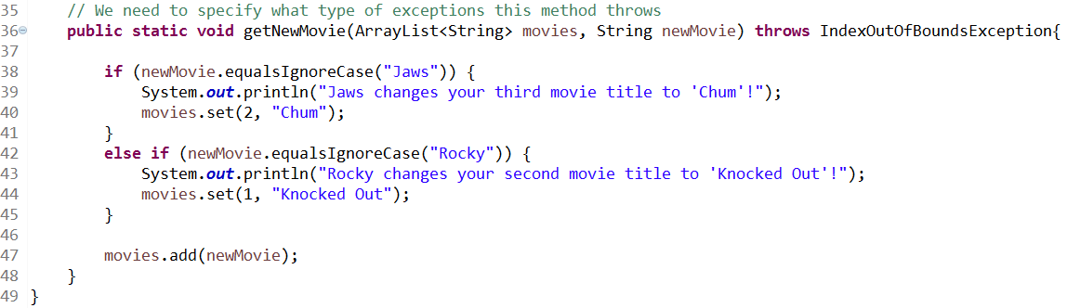
Exceptional Movies (Solution pt 2)

Slide 31
Questions?

